Slide 1




Slide 2

CALENDARS

Slide 3
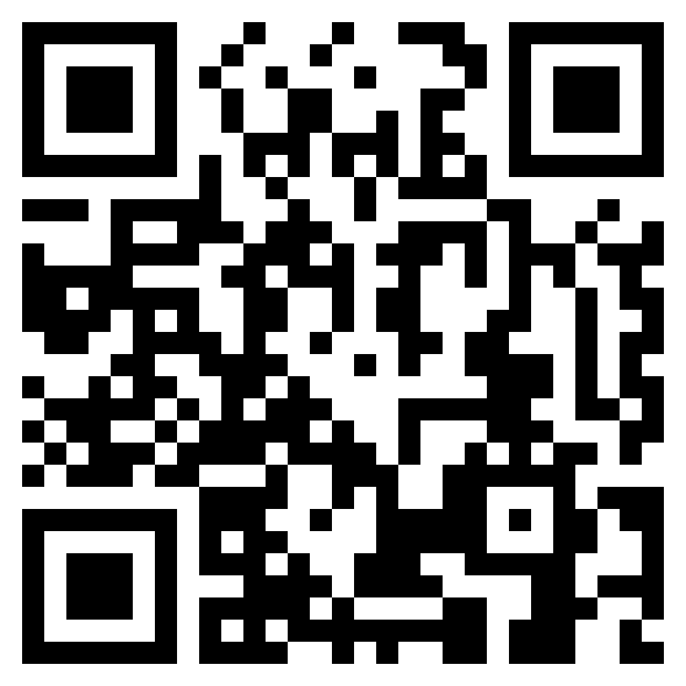
TEST TIME ON CLOCKS
URL: https://forms.gle/V6TAkgRbVKuENi1b9
QR CODE:

Slide 4
CALENDAR
The day of the week repeats after every seven days.
For any time period, the no. of days in excess over complete weeks are called odd days.
The non leap year- 365 days-52 weeks +1 odd day
Leap year- 366 days-52 weeks+2 odd days
A year is considered to be a leap year if:
a) The year can be evenly divided by 4;
b) If the year can be evenly divided by 100, it is NOT a leap year, unless;
c) The year is also evenly divisible by 400. Then it is a leap year
Leap years have 366 days. The extra day is added to February which has 29 days in a leap year.

Slide 5

The number of days per month in a normal year are:
Code for days:
SUNDAY | MONDAY | TUESDAY | WEDNESDAY | THURSDAY | FRIDAY | SATURDAY
0 | 1 | 2 | 3 | 4 | 5 | 6

Slide 6
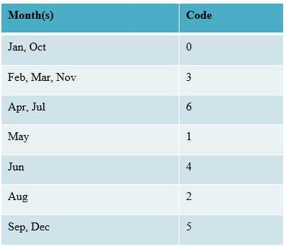
The month code

Slide 7
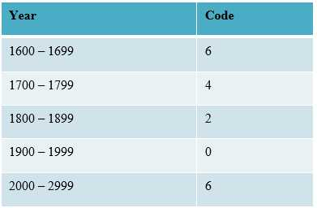
The year code

Slide 8
Step 1: Add the day digits to last two digits of the year.
Step 2: Divide the last two digits of the year by four and add it to the result in step 1.
Step 3: Add Month Code and year codes to the result obtain in step 3.
Step 4: Divide the result of step 4 by seven.
Step 5: Obtain the remainder and match with the day code.

Slide 9
Concept of ‘odd-days’
The concept of odd days is very important in determining the days of the week. Let us look at how many odd days will there be in a century – i.e. 100 years. There will be 24 leap years and 76 non–leap years. As studied earlier each leap year and 2 odd days and each non-leap year has 1 odd day. Therefore, there will be 24 × 2 + 76 × 1 = 124 total odd days. Since 7 odd days make a week, to find out the net odd days, divide 124 by 7. The remainder is 5 – this is the number of odd days in a century.

Slide 10
15 August 1947 came on which day of the week?
Step-1: Take the last two digits of the year given i.e. 47
Step-2:Add it to the code of year and given date i.e 47+0+15
Step-3:Divide 47 by 4 i.e 11 and ADD 11 to the result i.e 47+0+15+11
Step-4:Now ADD the month code to the result i.e. 47+0+15+11+2
Step-5:Divide the sum by 7 i.e 75/7 ;we get remainder 5
Step-6:Check the code for 5 i.e Friday!!! So 15 august 1947 was a Friday..!!

Slide 11
Month | Odd days
january | 3
february | 0
march | 3
april | 2
may | 3
june | 2
jully | 3

Slide 12
Month | Odd days
august | 2
september | 3
october | 2
november | 3
december | 2

Slide 13
Question : 01
What was the day on 15th august 1947 ?
Sunday
Monday
Friday
tuesday
Answer : C

Slide 14
Explanation
15 Aug, 1947 = (1946 years + Period from 1.1.1947 to 15.8.1947)
Odd days in 1600 years = 0
Odd days in 300 years = 1
46 years = (35 ordinary years + 11 leap years) = (35 x 1 + 11 x 2)= 57 (8 weeks + 1 day) = 1 odd day
Jan. Feb. Mar. Apr. May. Jun. Jul. Aug
( 31 + 28 + 31 + 30 + 31 + 30 + 31 + 15 ) = 227 days = (32 weeks + 3 days) = 3 odd days.
Total number of odd days = (0 + 1 + 1 + 3) = 5 odd days.
Hence, as the number of odd days = 5 , given day is Friday.
Notes:
D

Slide 15
Question : 02
Today is Monday. After 61 days, it will be :
Sunday
Monday
Wednesday
Saturday
Answer : D

Slide 16
Explanation
Each day of the week is repeated after 7 days. So, after 63 days, it will be Monday.
After 61 days, it will be Saturday.
Notes:
D

Slide 17
Question : 03
It was Sunday on Jan 1, 2006. What was the day of the week Jan 1, 2010?
Monday
Tueday
Friday
saturday
Answer : C

Slide 18
Explanation
On 31st December, 2005 it was Saturday.
Number of odd days from 2006 to 2009 = (1 + 1 + 2 + 1) = 5 days.
On 31st December 2009, it was Thursday.
Thus, on 1st Jan, 2010 it is Friday
Notes:
D

Slide 19
Question : 04
What was the day of the week on, 16th July, 1776
Tuesday
Wednesday
Sunday
monday
Answer : A

Slide 20
Explanation
16th July, 1776 = (1775 years + Period from 1st Jan, 1776 to 16th July, 1776)
Counting of odd days :
1600 years have 0 odd day.
100 years have 5 odd days.
75 years = (18 leap years + 57 ordinary years) = [(18 x 2) + (57 x 1)] = 93 (13 weeks + 2 days) = 2 odd days
1775 years have (0 + 5 + 2) odd days = 7 odd days = 0 odd day.
Jan Feb Mar Apr May Jun Jul
31 + 29 + 31 + 30 + 31 + 30 + 16 = 198 days= (28 weeks + 2 days)
Total number of odd days = (0 + 2) = 2. Required day was 'Tuesday'
Notes:
D

Slide 21
Question : 05
January 1, 2007 was Monday. What day of the week lies on Jan. 1, 2008?
Monday
Tuesday
Wednesday
thursday
Answer : B

Slide 22
Explanation
The year 2007 is an ordinary year. So, it has 1 odd day.
1st day of the year 2007 was Monday
1st day of the year 2008 will be 1 day beyond Monday
Hence, It will be Tuesday.
Notes:
D

Slide 23
Question : 06
The year next to 2005 will have the same calendar as that of the year 2005?
2016
2022
2011
2018
Answer : C

Slide 24
Explanation
Repetition of leap year ===> Add +28 to the Given Year.
Repetition of non leap year
Step 1 : Add +11 to the Given Year. If Result is a leap year, Go to step 2.
Step 2: Add +6 to the Given Year.
Solution :
Given Year is 2005, Which is a non leap year.
Step 1 : Add +11 to the given year (i.e 2005 + 11) = 2016, Which is a leap year.
Step 2 : Add +6 to the given year (i.e 2005 + 6) = 2011
Therfore, The calendar for the year 2005 will be same for the year 2011
Notes:
D

Slide 25
Question : 07
If every second Saturday and all Sundays are holidays in a 30 days month beginning on Saturday, then how many working days are there in that month?
A. 15
B. 18
C. 23
D. 25
Answer : C

Slide 26
Explanation
Since the month begins on Saturday, so 2nd, 9th, 16th, 23rd, 30th days are Sundays.
While 8th and 22nd days are second Saturdays.
Thus, there are 7 holidays in all.
Therefore number of working days = 30 – 7 = 23.
Notes:
D

Slide 27
Question : 08
What was the day of the week on 17th June, 1998?
Sunday
wednesday
Tuesday
thursday
Answer : B

Slide 28
Explanation
Year Code: 0, Month Code: 4, Day digits = 17, Last 2 digits of the year = 98.
1. 17 + 98 = 115.
2. Quotient of 98 / 4 = 24, 115 + 24 = 139.
3. 139 + 4 + 0 = 143.
4. Remainder of 143 / 7 = 3.
5. Day code 3 = Wednesday.
Notes:
D

Slide 29
Question : 09
X was born on March 6, 1993. The same year Independence Day was celebrated on Friday. On which day was X born?
A. Monday
B. Wednesday
C. Thursday
D. Friday
Answer : C

Slide 30
Explanation
Number of days from March 6, 1993 to August 15, 1993.
Mar Apr May June July August
= 25 + 30 + 31 + 30 + 31 + 15
= 162 days = 23 weeks + 1 day.
Clearly, the day on March 6 will be the same as on August 14, i.e., Thursday.
Notes:
D

Slide 31
Question : 10
If Thursday was the day after the day before yesterday five days ago, What is the least number of days ago when Sunday was three days before the day after tomorrow?
A. Two
B. Three
C. Four
D. Five
Answer : A

Slide 32
Explanation
Day after the day before yesterday is yesterday.
Now, five days ago, yesterday was thursday.
So, five days ago, it was Friday.
Therefore today is wednesday.
Now, three days before the day after tomorrow is yesterday.
Now, it is on Monday that we say Yesterday was Sunday.
Notes:
D

Slide 33
Question : 11
If the second day of a month is a Friday, which of the following would be the last day of the next month which has 31 days?
A. Sunday
B. Monday
C. Wednesday
D. Data inadequate
Answer : D

Slide 34
Explanation
The number of days in the current month is not mentioned.
Notes:
D

Slide 35
Question : 12
The calendar of the year 2024 can be used again in the year?
2030
2040
2052
2048
Answer : C

Slide 36
Explanation
Repetition of leap year ===> Add +28 to the Given Year.
Repetition of non leap year
Step 1 : Add +11 to the Given Year. If Result is a leap year, Go to step 2.
Step 2: Add +6 to the Given Year.
Solution :
Given Year is 2024, Which is a leap year.
So, Add +28 to the given year (i.e 2024 + 28) = 2052
Therfore, The calendar of the year 2024 can be used again in the year 2052.
Notes:
D

Slide 37
Question : 13
Mr. Khan has celebrated his birthday on Tuesday 30th, September 1997. When will he celebrate his birthday on the same day again?
30 Sept 2004
30 Sept 2002
30 Sept 2001
30 Sept 2003
Answer : D

Slide 38
Explanation
The name day will be repeated after every 7 days. 1997 is an ordinary so it will have 1 odd day and thus 1998 will also gain 1 day.
Thus on 30th September 2003, Mr Khan will celebrate his birthday again on Tuesday.
Notes:
D

Slide 39
Question : 14
The calendar for the year 1988 is same as which upcoming year ?
2014
2016
2012
2010
Answer : B

Slide 40
Explanation
We already know that the calendar after a leap year repeats again after 28 years.
Here 1988 is a Leap year, then the same calendar will be in the year = 1988 + 28 = 2016.
Notes:
D

Slide 41
Question : 15
If every seconds Saturday and all Sundays are holidays in a 30 days month beginning on Saturday, then how many working days are there in that month ? (Month starts from Saturday)
25
23
24
22
Answer : B

Slide 42
Explanation
As month begins on Saturday, so 2nd, 9th, 16th, 23rd, 30th days will be Sundays. While 8th and 22nd days are second Saturdays. Thus, there are 7 holidays in all.
Hence, no. of working days = 30 – 7 =23
Notes:
D

Slide 43
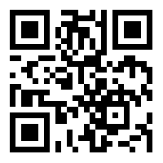
https://learn.codemithra.com

Slide 44




THANK YOU
+91 78150 95095
codemithra@ethnus.com
www.codemithra.com

